Slide 1
Comparing country life expectancy and GDP
Scotty Dunn, Christopher Joseph, and Ashley Nguyen

Slide 2
Our data
Why we choose these data sets
Higher GDP can provide better healthcare infrastructure, living standards, and quality education
Investigate if this would then correlate to a higher life expectancy
Life expectancy around the world dataset from UN World Population Prospects
Kaggle
40.75 mB
Annual death rate by country and year
Energy Consumption and Mix Dataset from Our World in Data
Kaggle
8.42 mB
Global, regional, and country-level data on primary energy consumption, energy mix, electricity mix, fossil fuel production, and related energy metrics (including GDP per capita) by year
Notes:
Gross domestic product measures the value of all goods and services produced in an economy over a specific period of time
Often reflects stronger economic resources (healthcare infrastructure, living standards, and quality education)
Countries with higher GDPs tend to have better access to advanced medical technology, trained professionals, and preventive care
This can contribute directly to reducing mortality rates and increasing life expectancy
Aim to explore if higher GDP consistently correlates with longer life expectancy across different regions
Understanding this relationship can inform policymaking and resource allocation in lower-GDP regions to improve life expectancy and quality of life

Slide 3
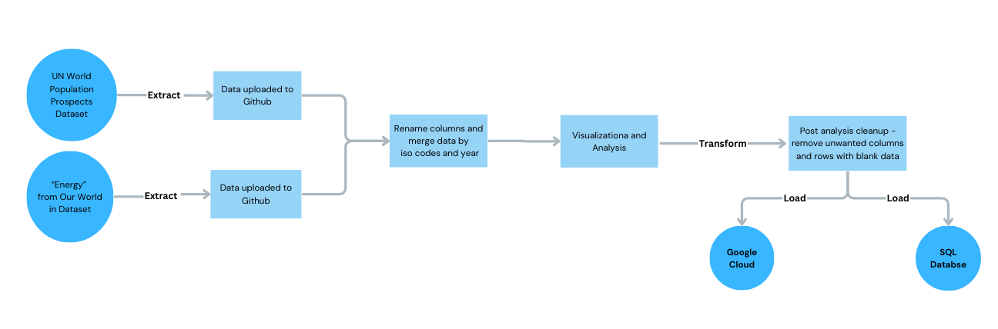
ETL Pipeline

Slide 4
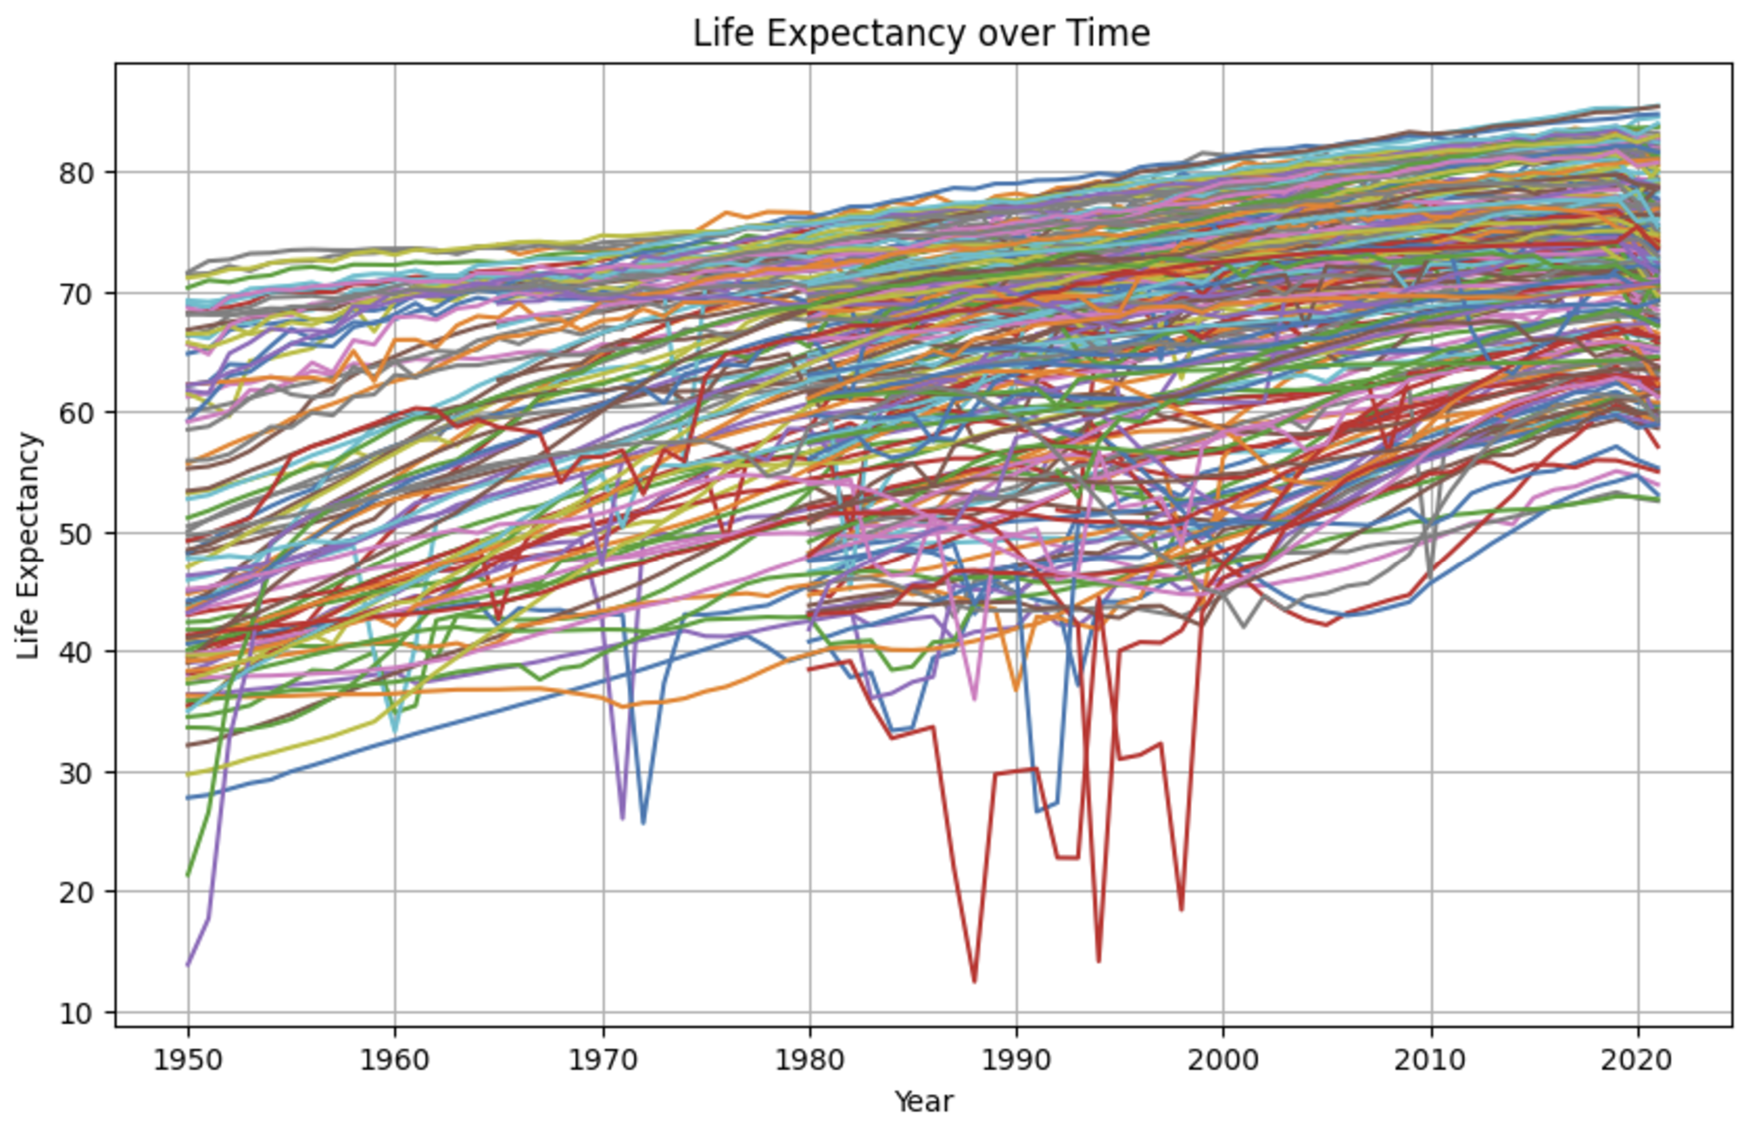
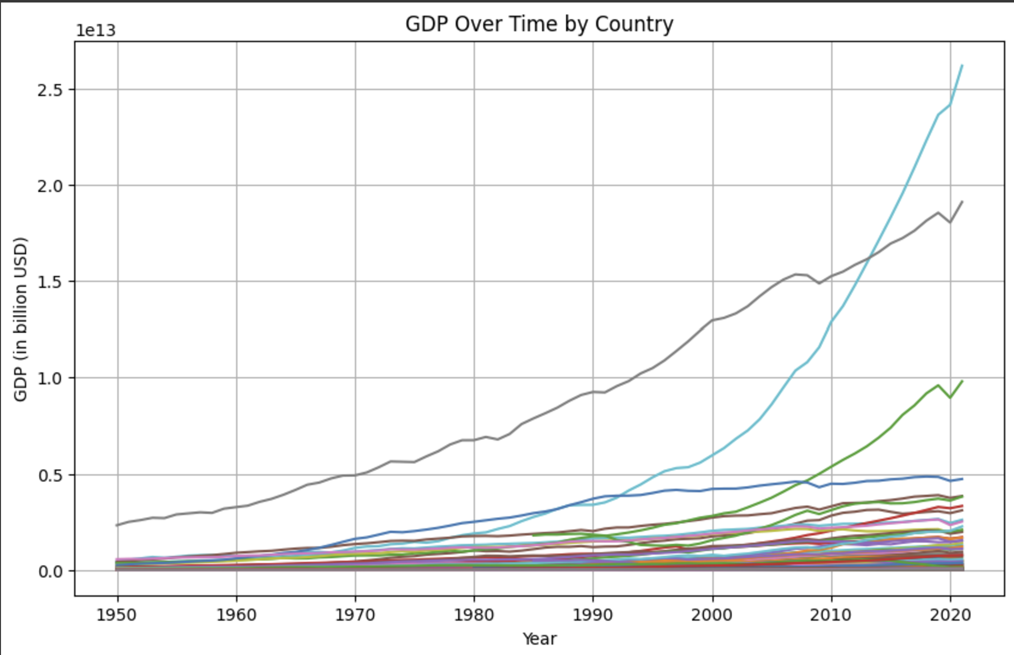
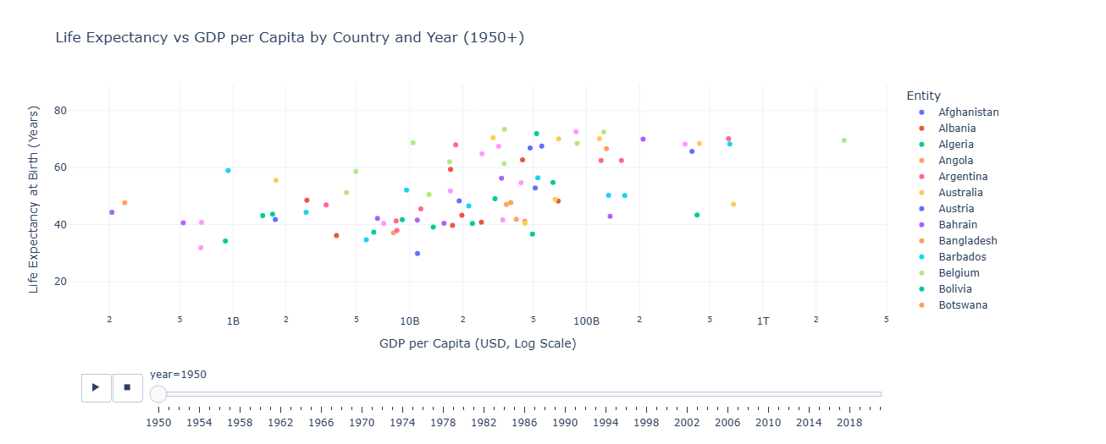
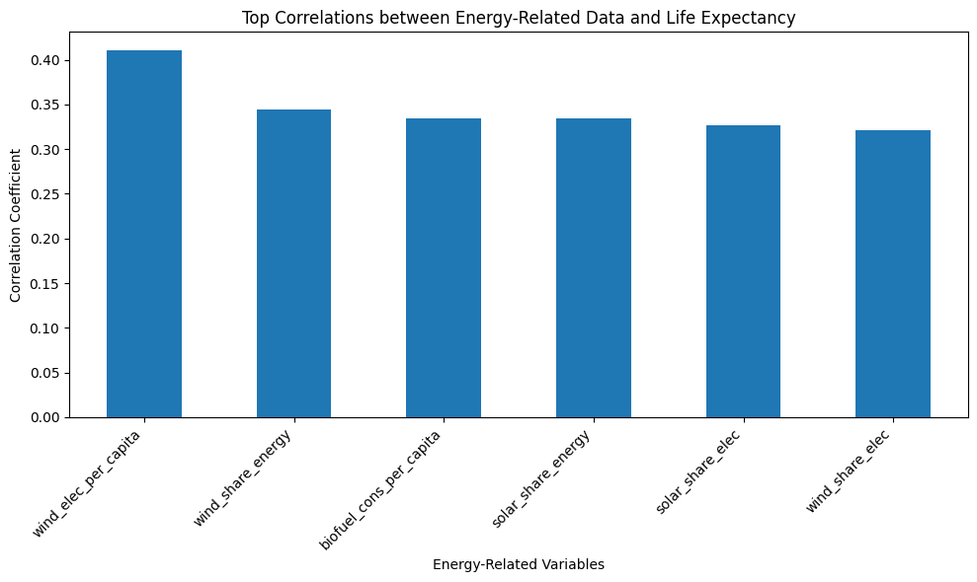
Data Analysis and Visualization
Life expectancy and GDP for most countries have for the most part increased over time
Overall positive correlation between life expectancy and GDP over time (r=.04)

Slide 5
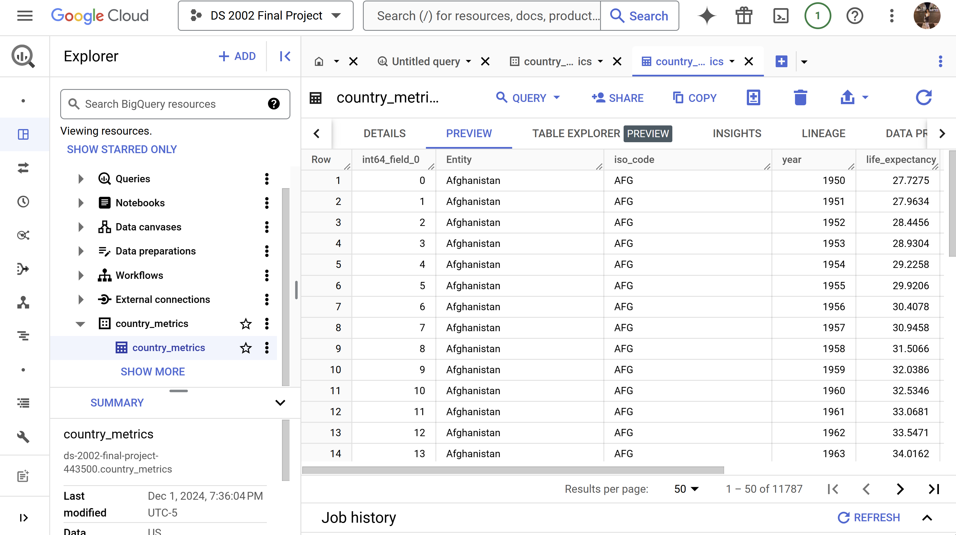
Cloud Storage

